Slide 1


Blueprint Datathon ---Predicting Diagnostics Results
Andrew Zhu
University of Pennsylvania

Slide 2

Key Takeaways
Prediction model achieved an AUC score of 0.72
Country provides useful a priori information for prediction
No single metric can predict diagnostics results
More features needed more better prediction

Slide 3
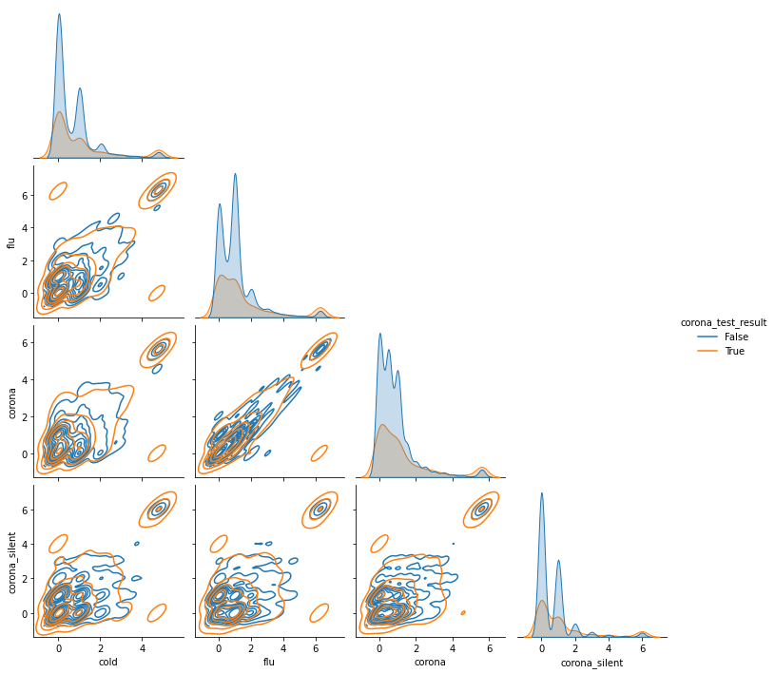
Exploratory Data Analysis
Pair Plot of Four Metrics
Notes:
I noticed that there are no duplicates or null values.
Flu score correlate with corona virus score as expected
No single predictor of COVID test result
Created_at column is irrelevant information according to documentation
Create one hot encoding from country columns

Slide 4
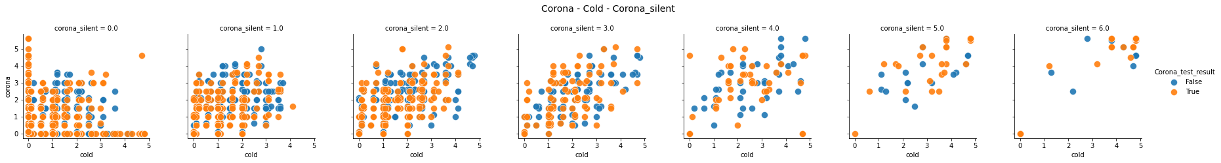
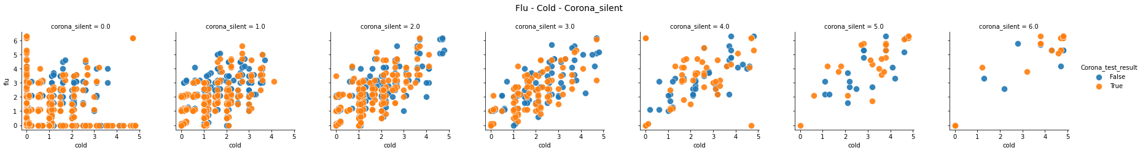
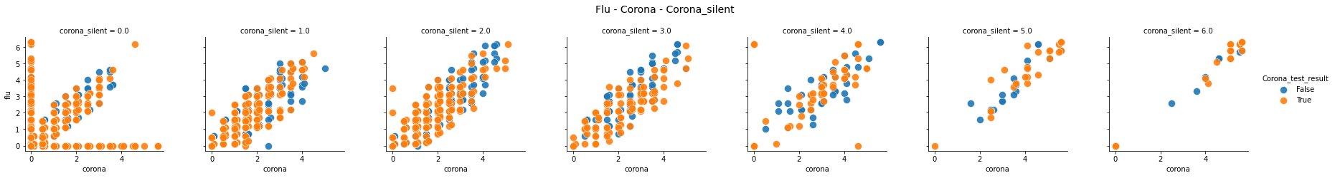
Visualization

Slide 5
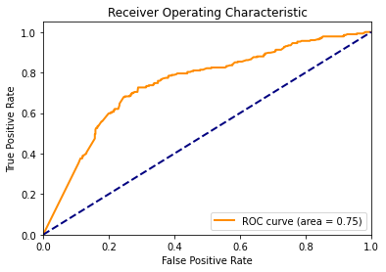
Multilayer Perceptron
Simplest model works best
Powerful for classification given metrics instead of raw data
Layers[139, 50, 10,1]
Learning rate 0.005
Adam optimizer
2000 epoch
Custom loss function
Notes:
Simplest model to try
Since the features

Slide 6
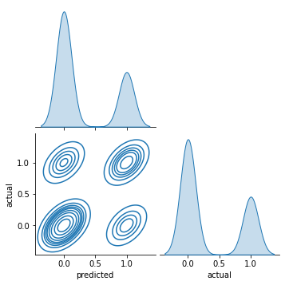
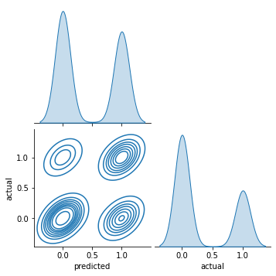
Custom Loss Function
$Loss$ $=\left|Estimate−Target\right|+ α[Target ×\left(1 −Estimate\right)]$
Notes:
Custom loss function to penalize false negatives
Tunable parameter alpha depending on the cost of false negatives

Slide 7
Simpler is Better!
Notes:
Tried other models such as Graph Neural Networks to explore how each metric affects each other. No success!

Slide 8
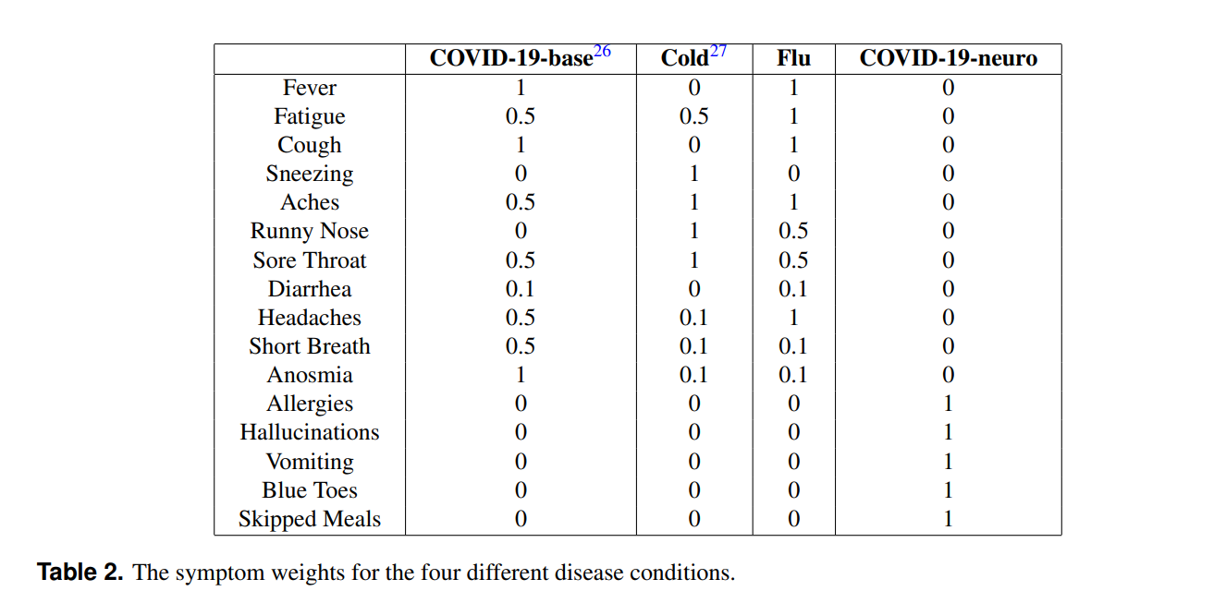
Discussion
Loss of dimensionality of data due to metric calculation
Metric calculation makes it difficult to differentiate COVID and Flu scores
There may be a trade off between granularity of data and user privacy protection
Notes:
More feature better prediction
Trade off between accuracy and privacy

Slide 9
Some Surprising Discoveries
Achieved AUC score of 0.68 with country data alone
AUC score of 0.59 without country data
Missing any one/two metrics does not affect AUC score much, except corona_silent

Slide 10
Conclusion
Achieved higher AUC score than original FeverIQ paper
Country information is important
Custom loss function penalizing false negatives is important
Higher accuracy is difficult to achieve without more available features

Slide 11
References and Acknowledgements
A. Ranjan, S. Li, B. Chen, K. A. Jagadeesh, and A. Chiu, “FeverIQ - A Privacy-Preserving COVID-19 Symptom Tracker with 3 . 6 Million Reports,” 2020.
E. Isufi, F. Gama, and A. Ribeiro, "EdgeNets: Edge Varying Graph Neural Networks," submitted to IEEE Trans. Pattern Analysis and Mach. Intell.
Thanks to Enya.AI for providing the dataset

